Slide 1


Fundamentals of Music Processing
Chapter 3: Music Synchronization
Meinard Müller
International Audio Laboratories Erlangen
www.music-processing.de

Slide 2
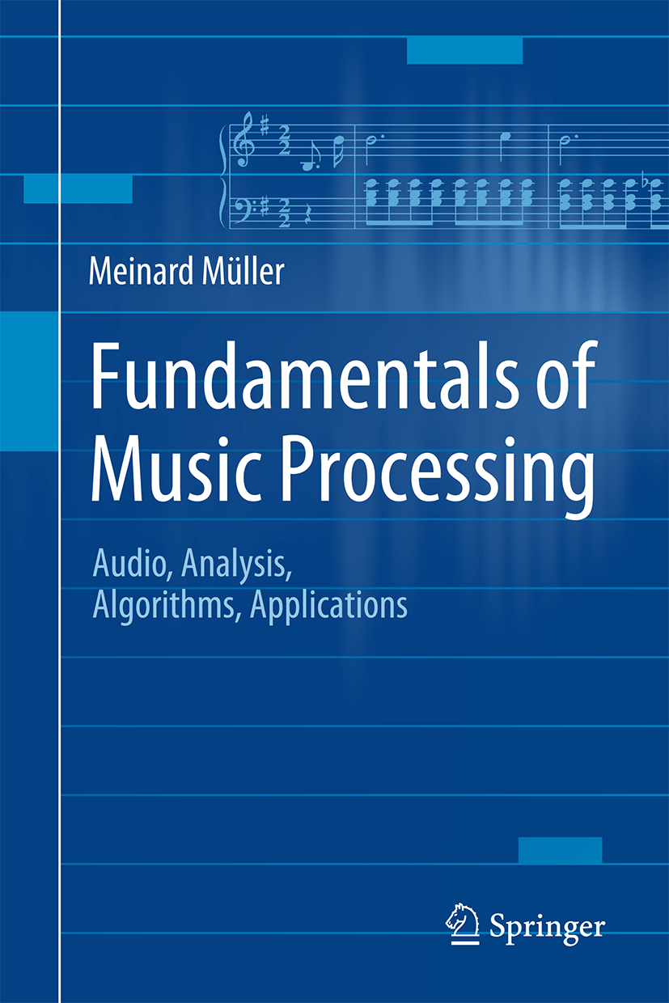

Book: Fundamentals of Music Processing
Meinard Müller
Fundamentals of Music Processing
Audio, Analysis, Algorithms, Applications
483 p., 249 illus., 30 illus. in color, hardcover
ISBN: 978-3-319-21944-8
Springer, 2015
Accompanying website:
www.music-processing.de

Slide 3
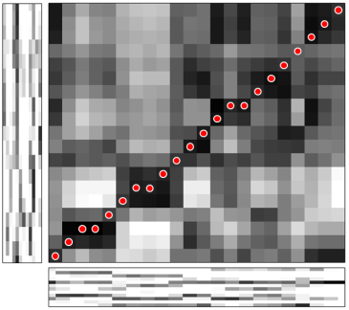
Chapter 3: Music Synchronization
3.1 Audio Features
3.2 Dynamic Time Warping
3.3 Applications
3.4 Further Notes
As a first music processing task, we study in Chapter 3 the problem of music synchronization. The objective is to temporally align compatible representations of the same piece of music. Considering this scenario, we explain the need for musically informed audio features. In particular, we introduce the concept of chroma-based music features, which capture properties that are related to harmony and melody. Furthermore, we study an alignment technique known as dynamic time warping (DTW), a concept that is applicable for the analysis of general time series. For its efficient computation, we discuss an algorithm based on dynamic programming—a widely used method for solving a complex problem by breaking it down into a collection of simpler subproblems.

Slide 4
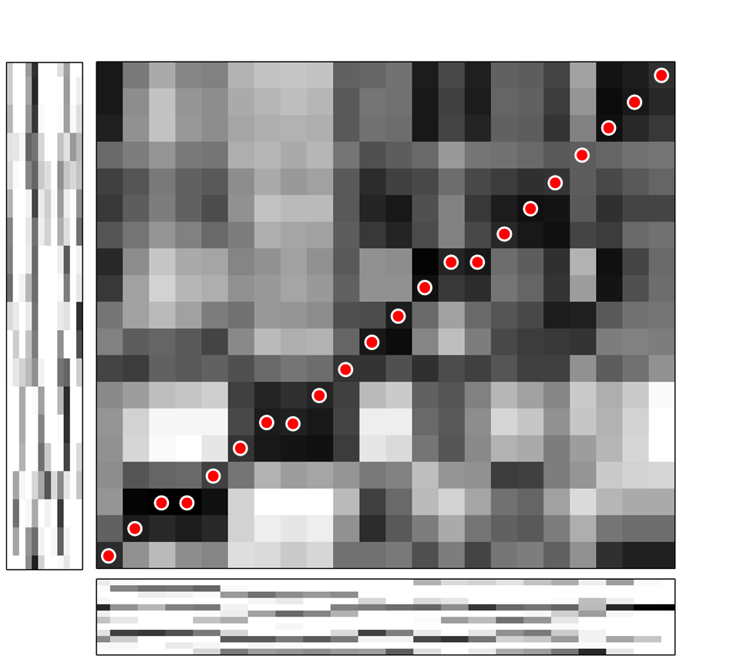
3 Music Synchronization
Teaser

Slide 5
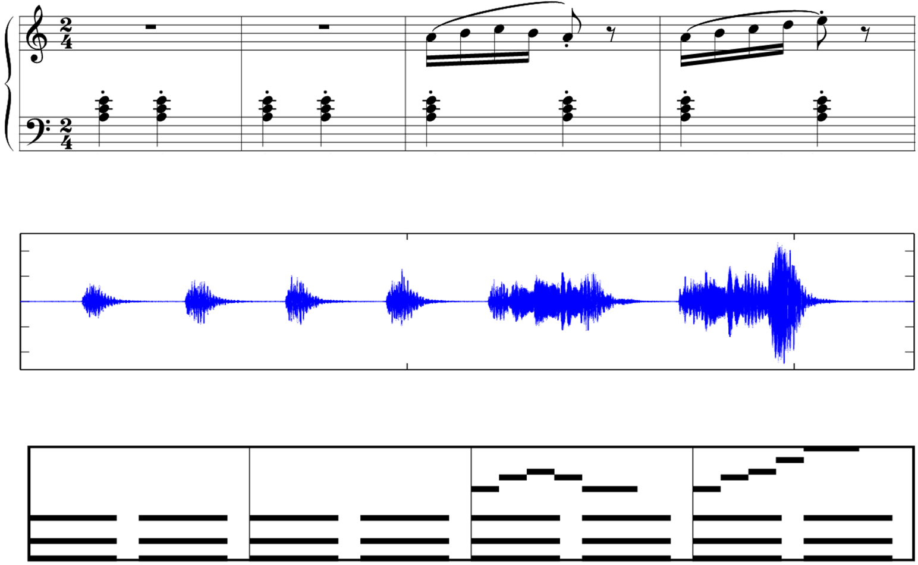
3 Music Synchronization
Fig. 3.1

Slide 6
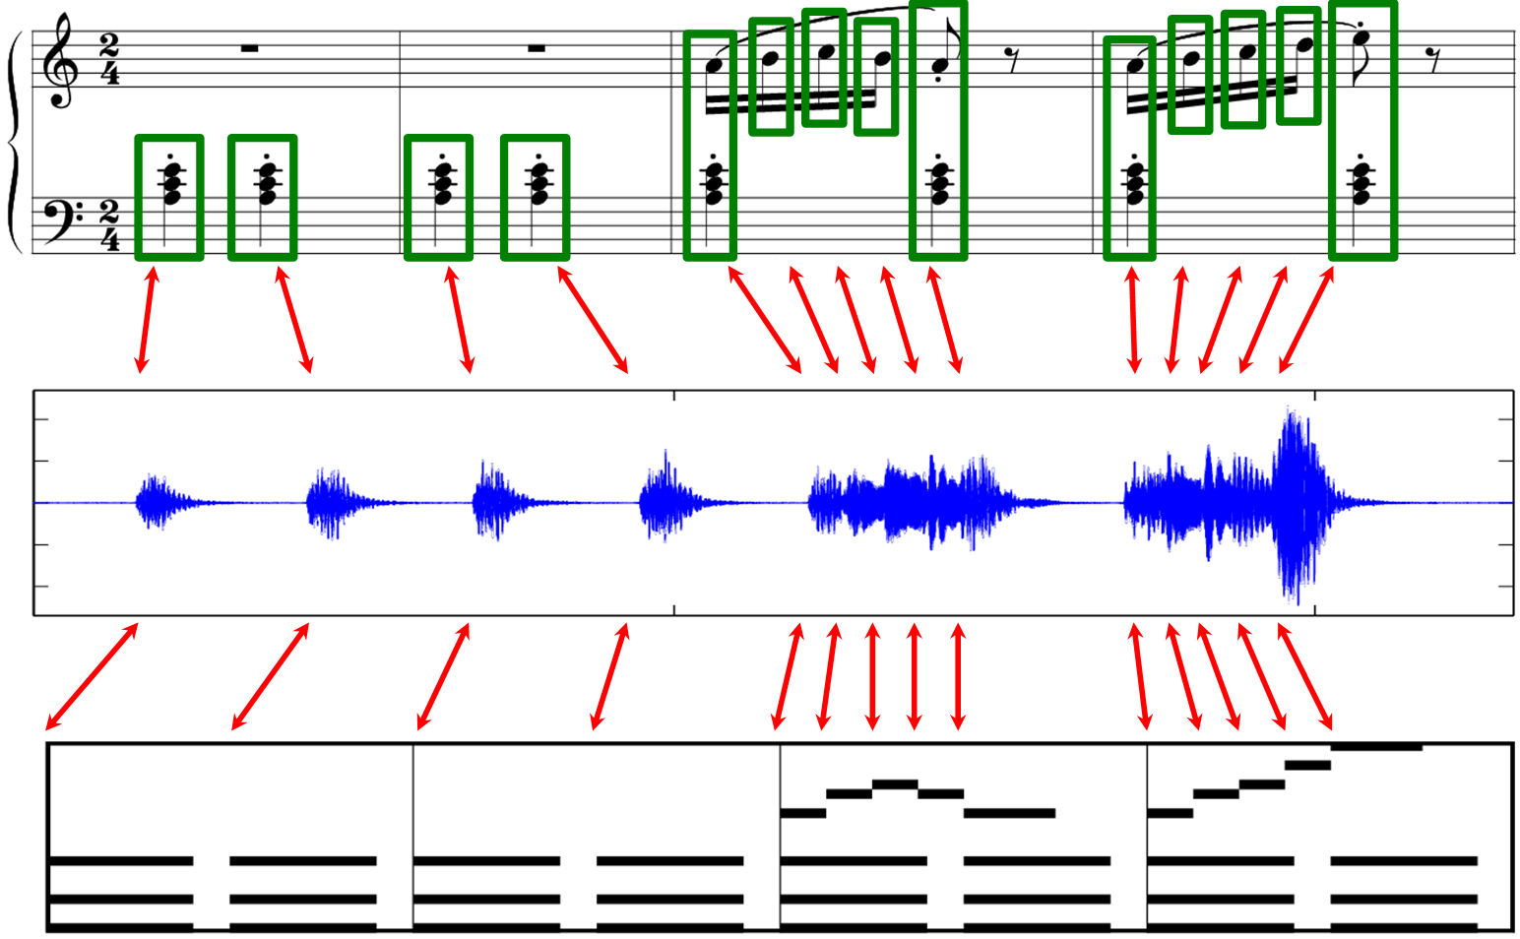
3 Music Synchronization
Fig. 3.1

Slide 7
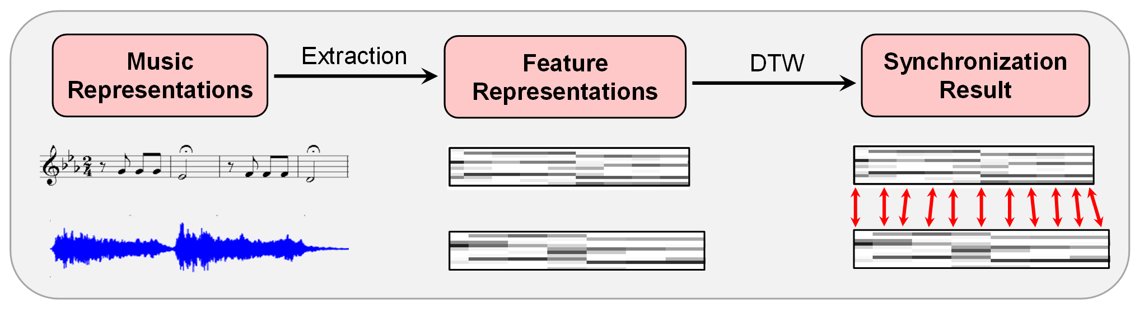
3 Music Synchronization
Fig. 3.2

Slide 8
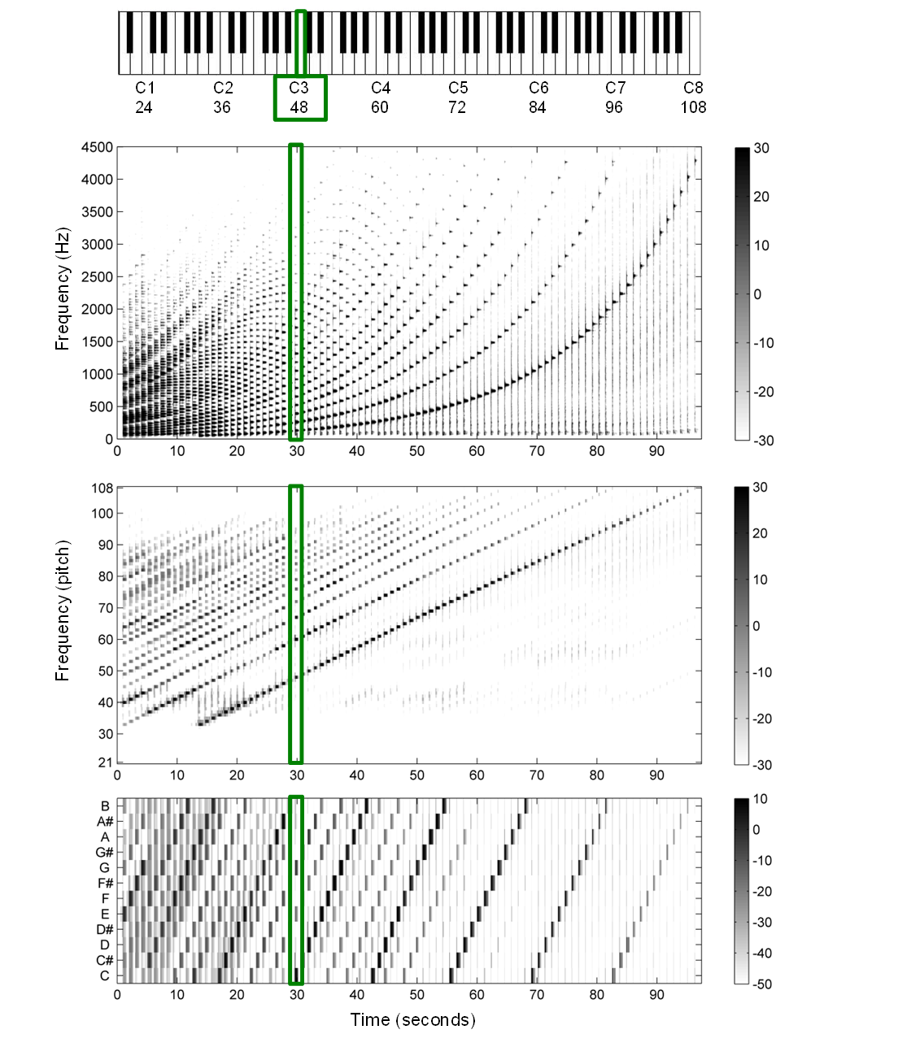
3.1 Audio Features
Fig. 3.3

Slide 9
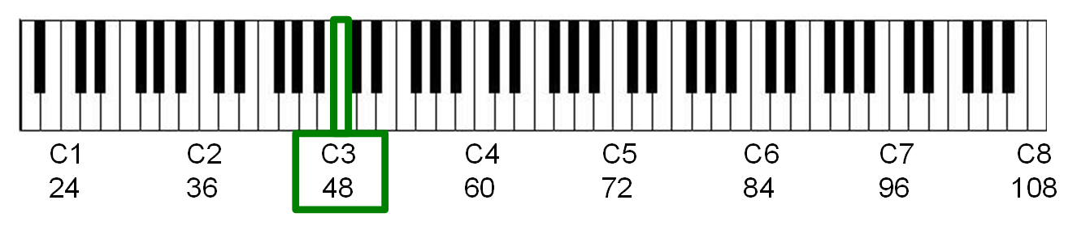
3.1 Audio Features
Fig. 3.3
Frequency (Hz)
Time (seconds)

Slide 10
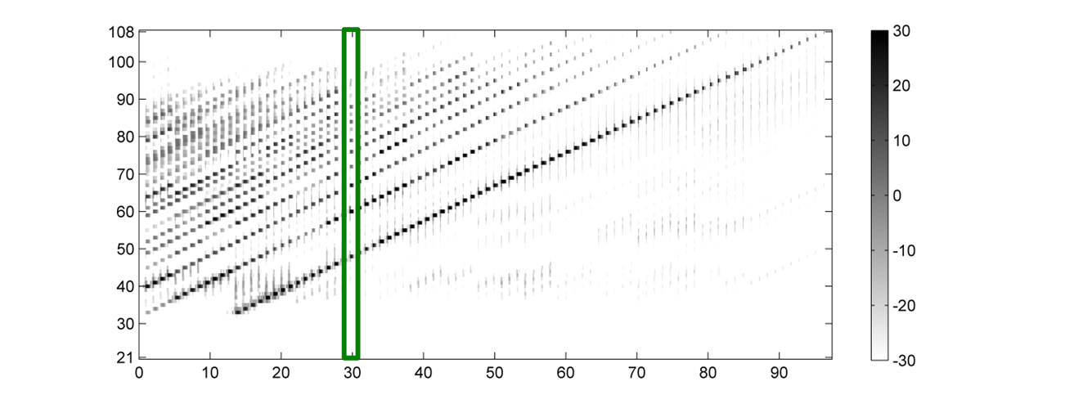
3.1 Audio Features
Fig. 3.3
Frequency (pitch)
Time (seconds)

Slide 11
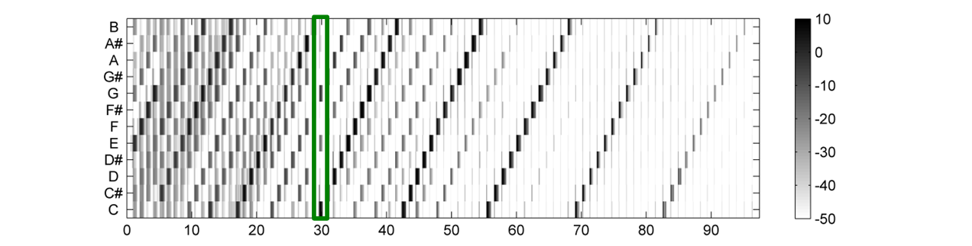
3.1 Audio Features
Fig. 3.3
Chroma
Time (seconds)

Slide 12
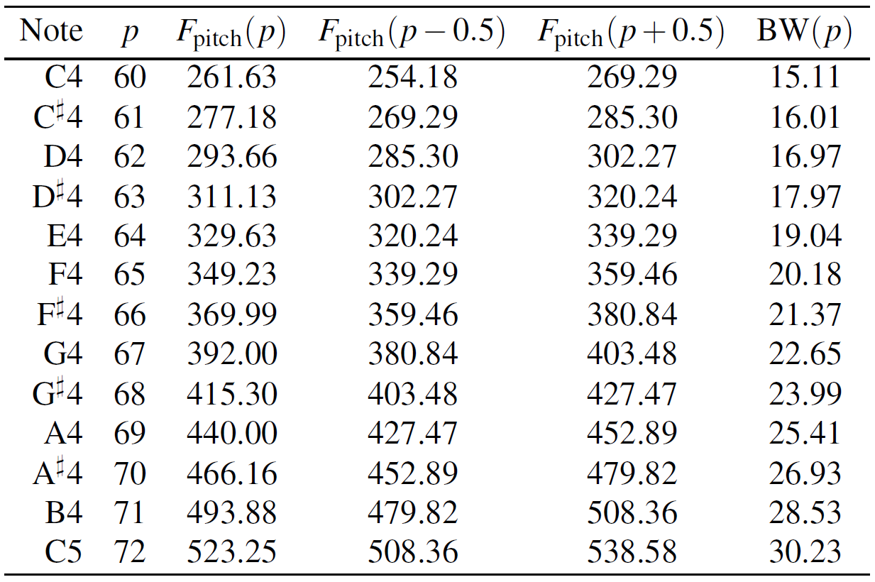
3.1 Audio Features
Table 3.1

Slide 13
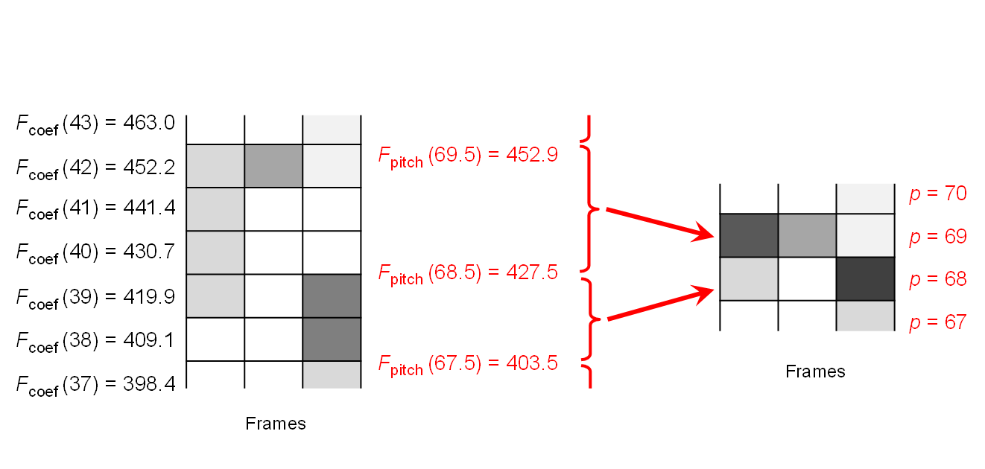
3.1 Audio Features
Fig. 3.4

Slide 14
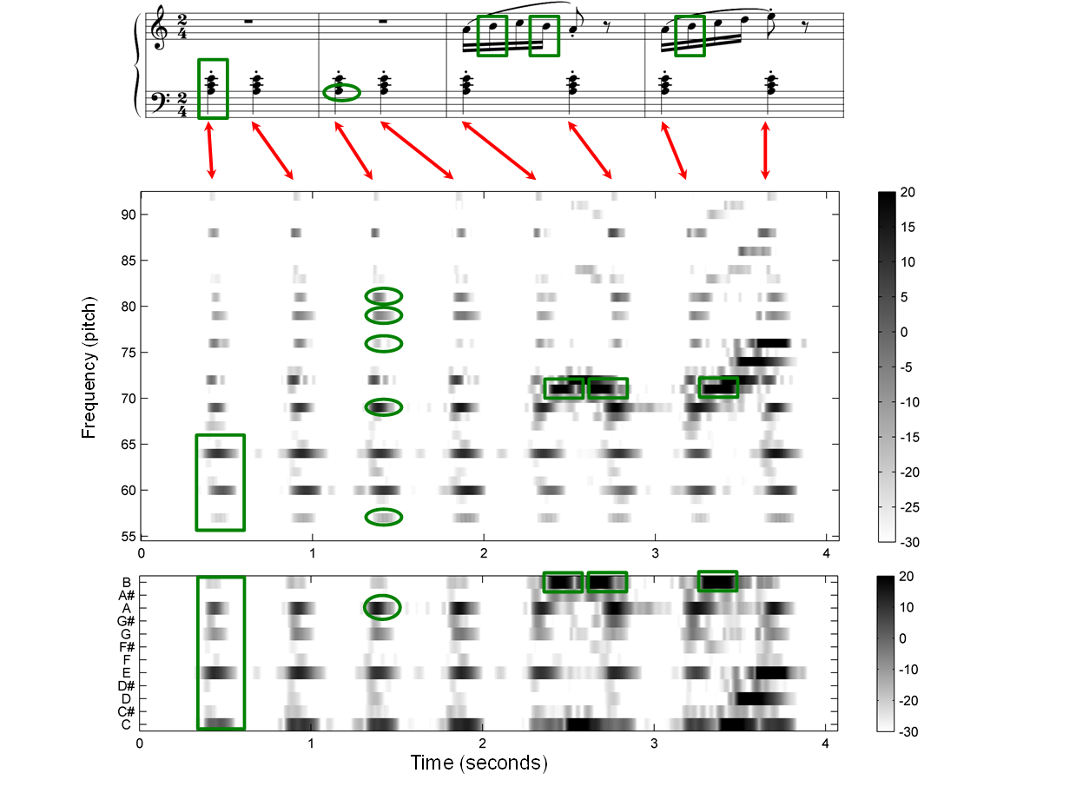
3.1 Audio Features
Fig. 3.5

Slide 15
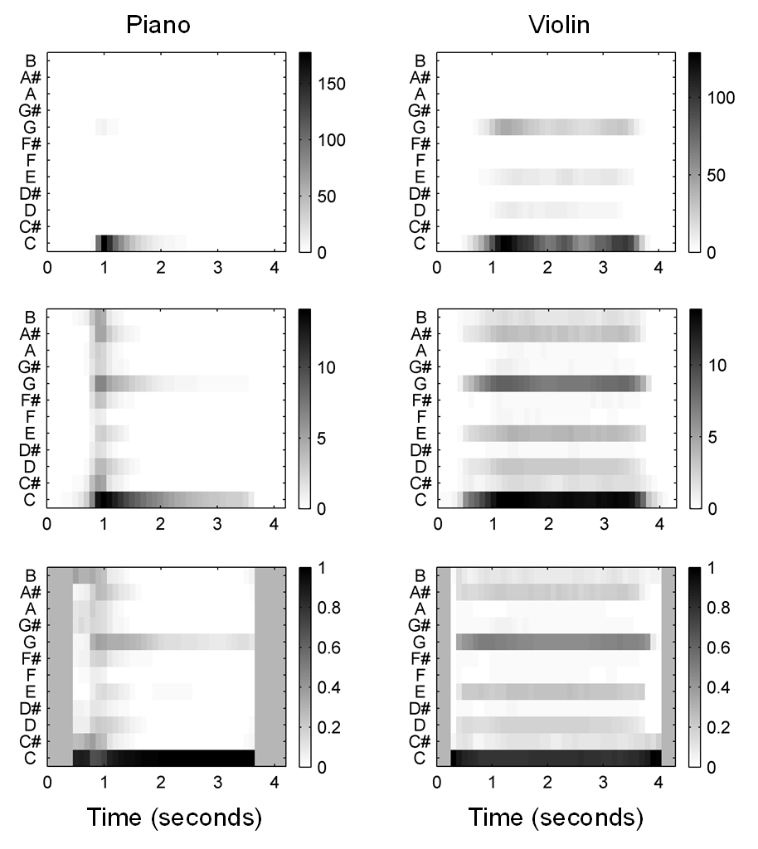
3.1 Audio Features
Fig. 3.6

Slide 16
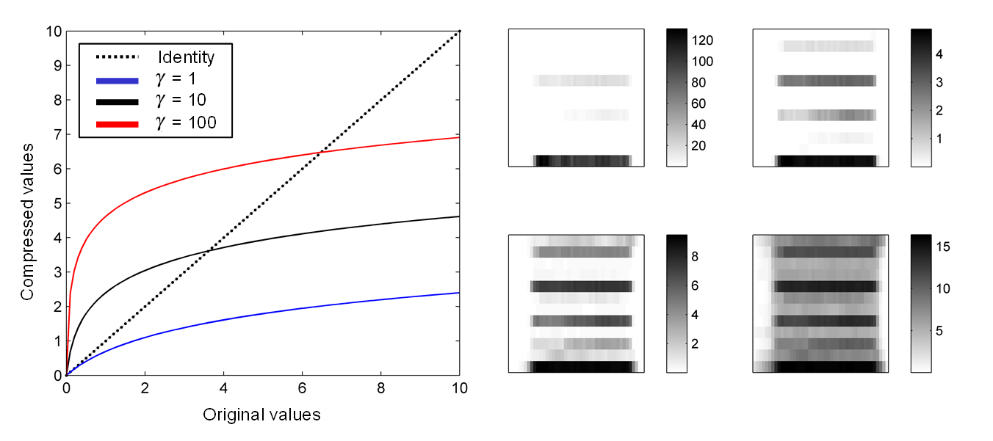
3.1 Audio Features
Fig. 3.7

Slide 17
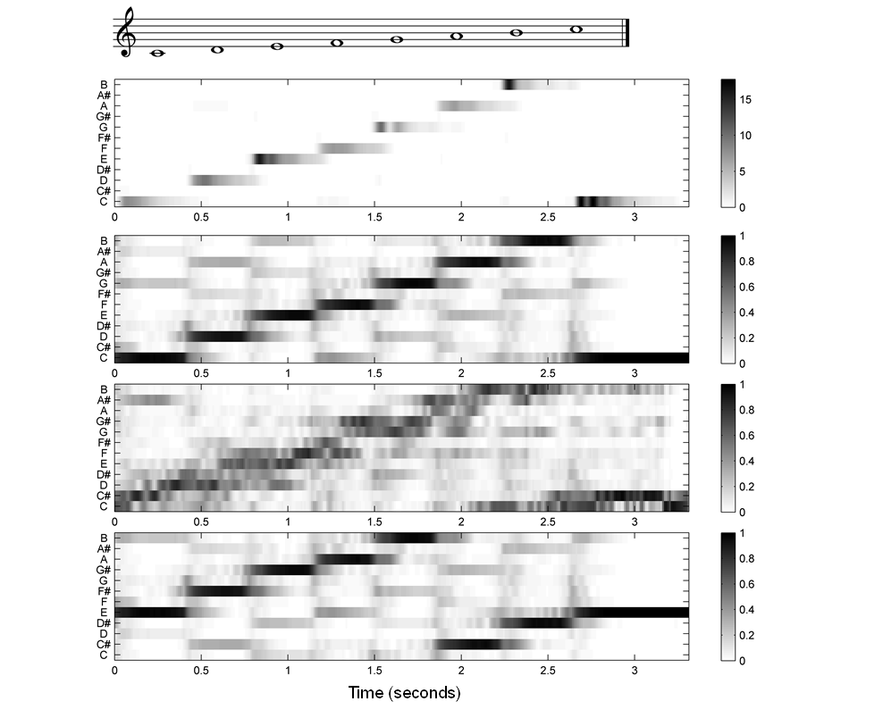
3.1 Audio Features
Fig. 3.8

Slide 18
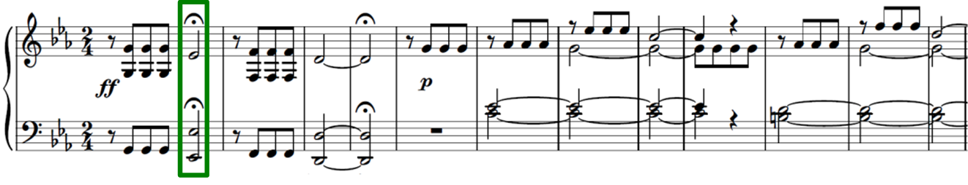
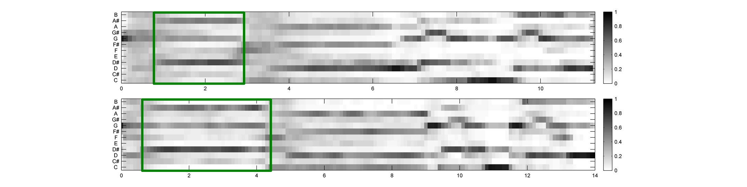
3.1 Audio Features
Fig. 3.9
Time (seconds)

Slide 19
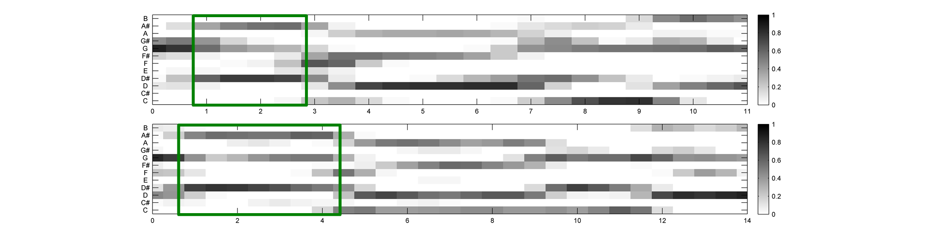
3.1 Audio Features
Fig. 3.9
Time (seconds)

Slide 20
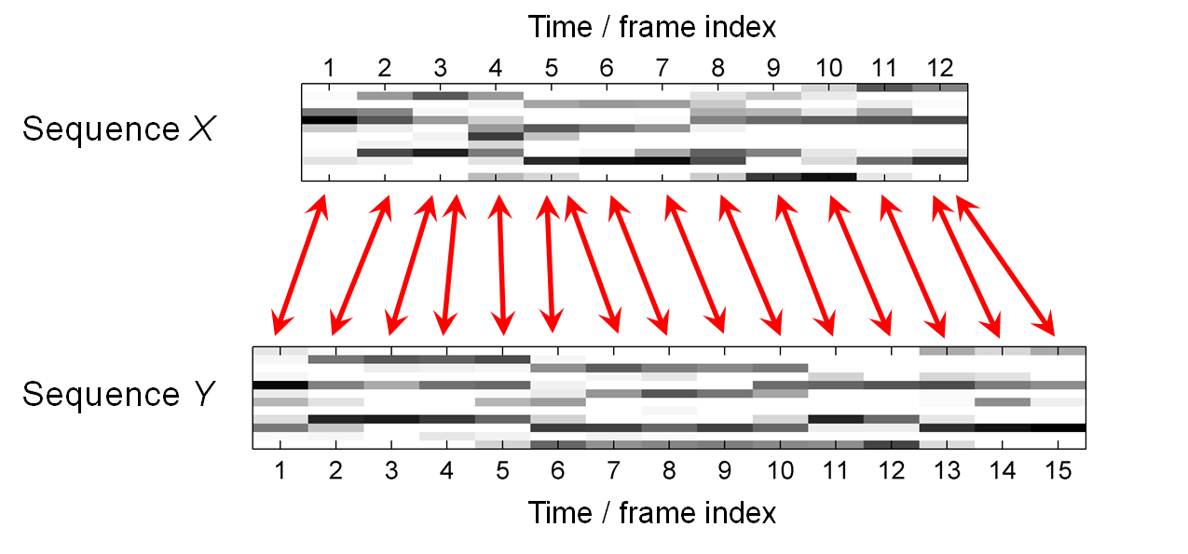
3.2 Dynamic Time Warping
Fig. 3.10

Slide 21
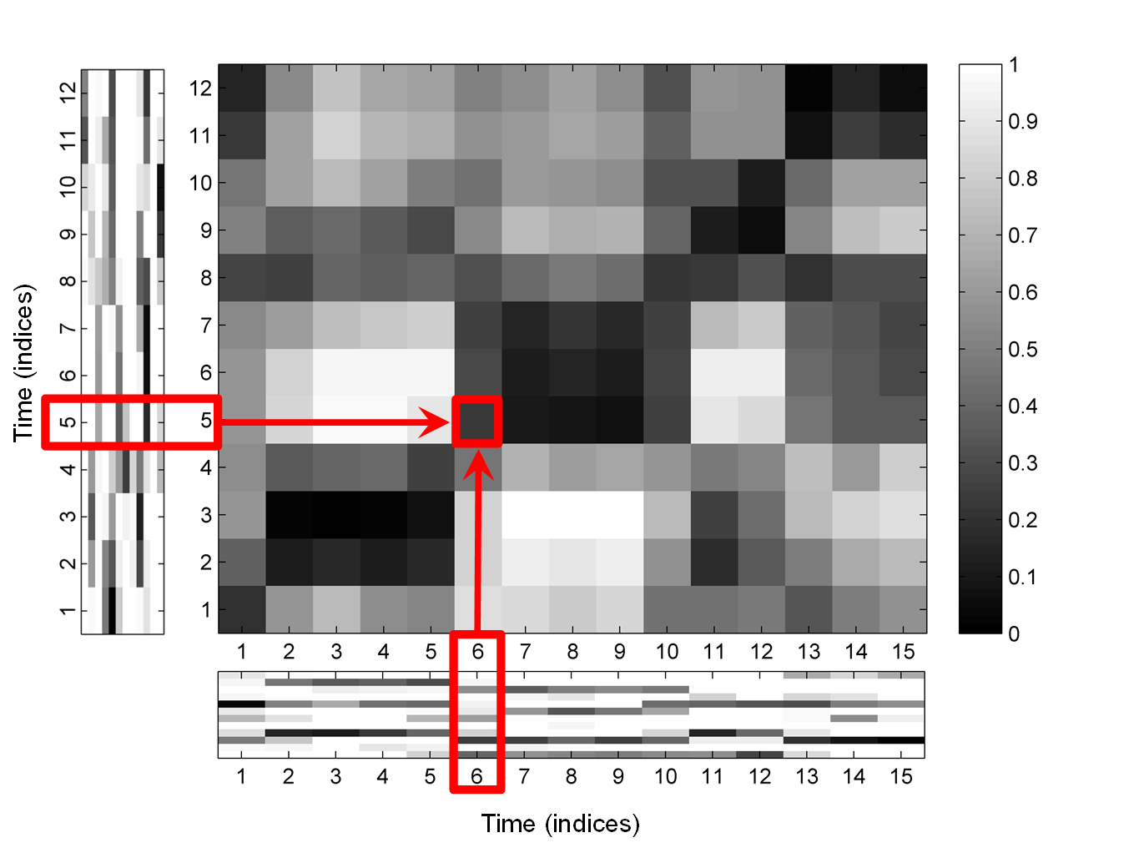
3.2 Dynamic Time Warping
Fig. 3.11

Slide 22
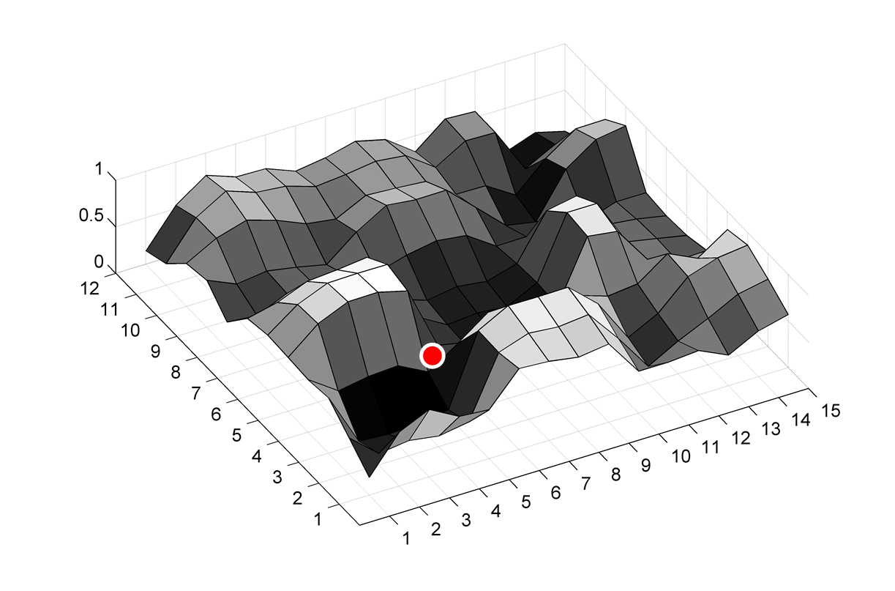
3.2 Dynamic Time Warping
Fig. 3.11

Slide 23
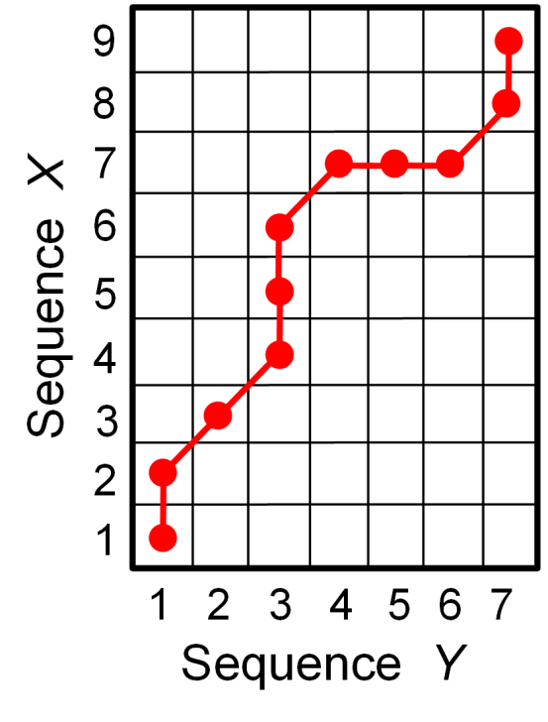
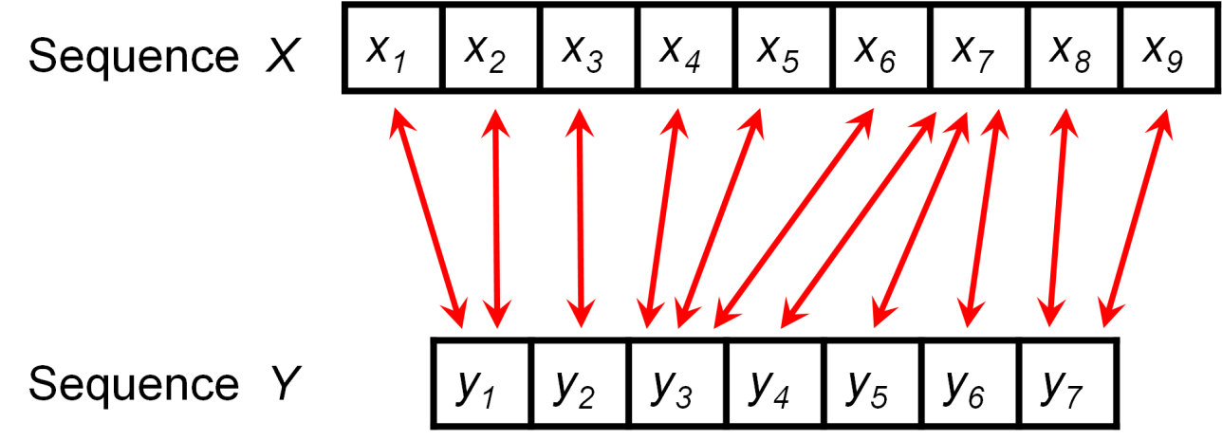
3.2 Dynamic Time Warping
Fig. 3.12

Slide 24
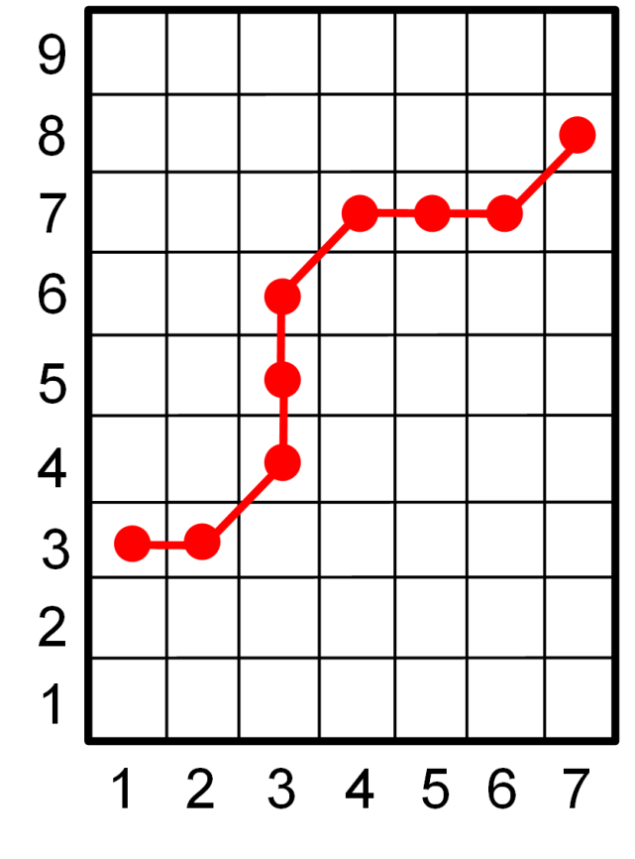
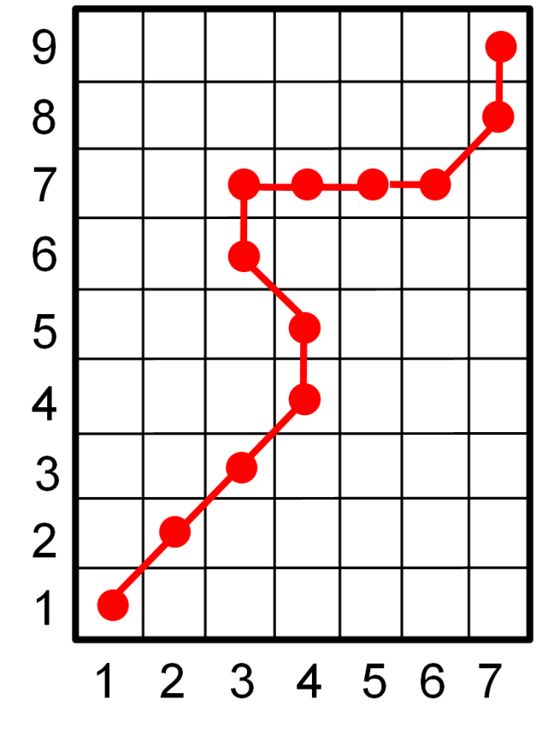
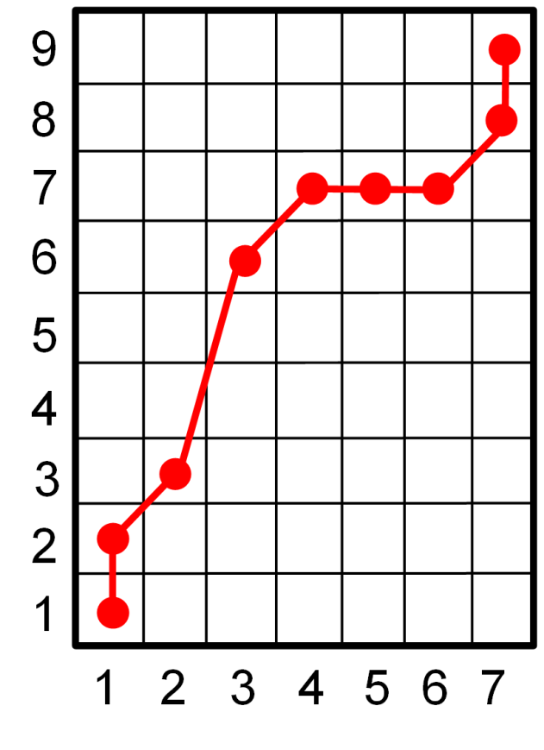
3.2 Dynamic Time Warping
Fig. 3.13

Slide 25
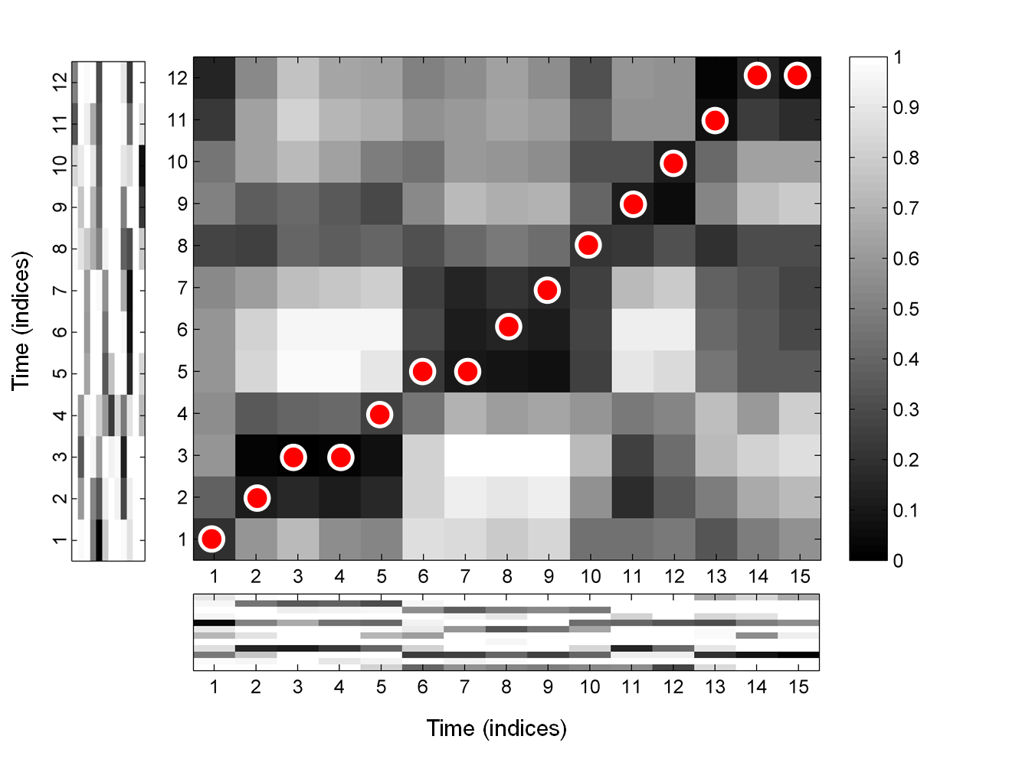
3.2 Dynamic Time Warping
Fig. 3.14

Slide 26
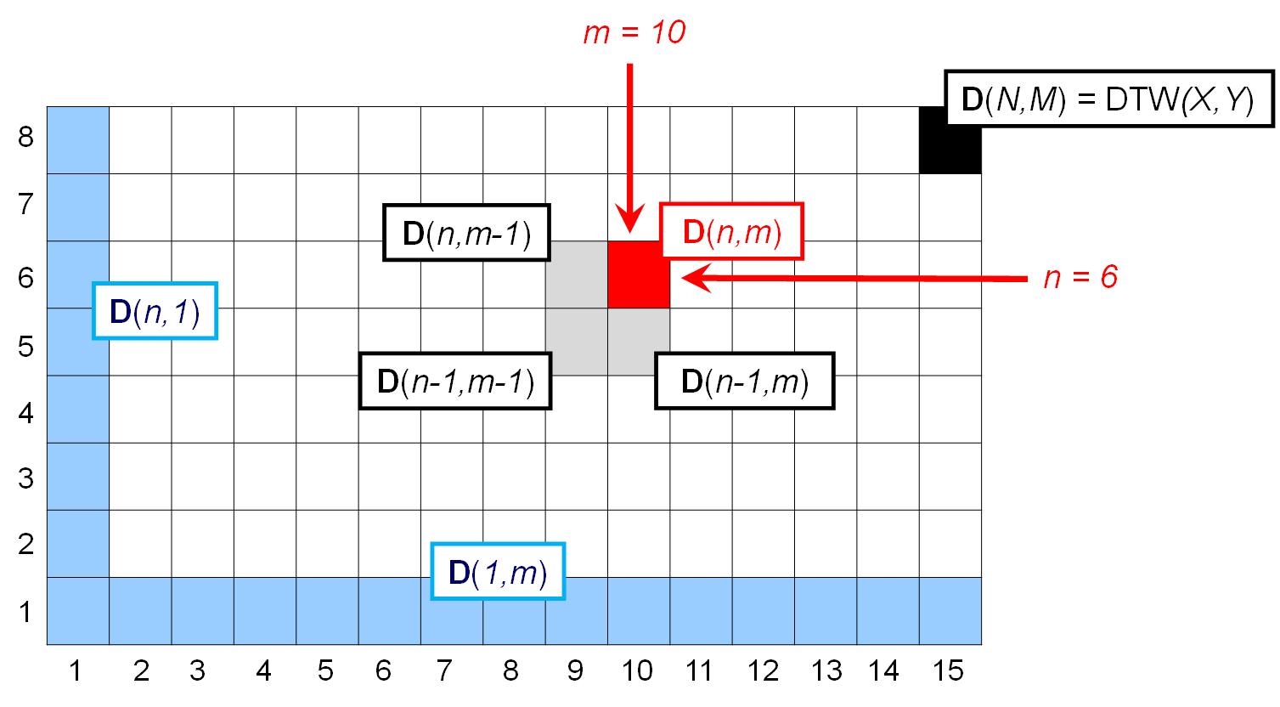
3.2 Dynamic Time Warping
Fig. 3.15

Slide 27
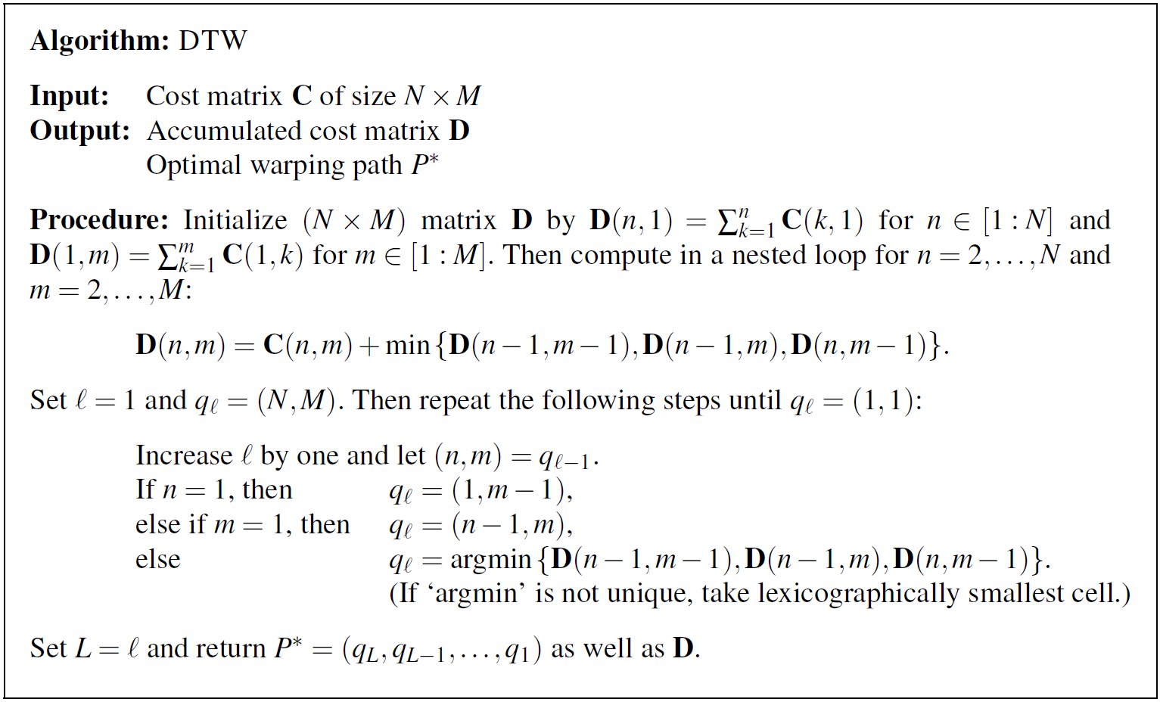
3.2 Dynamic Time Warping
Table 3.2

Slide 28
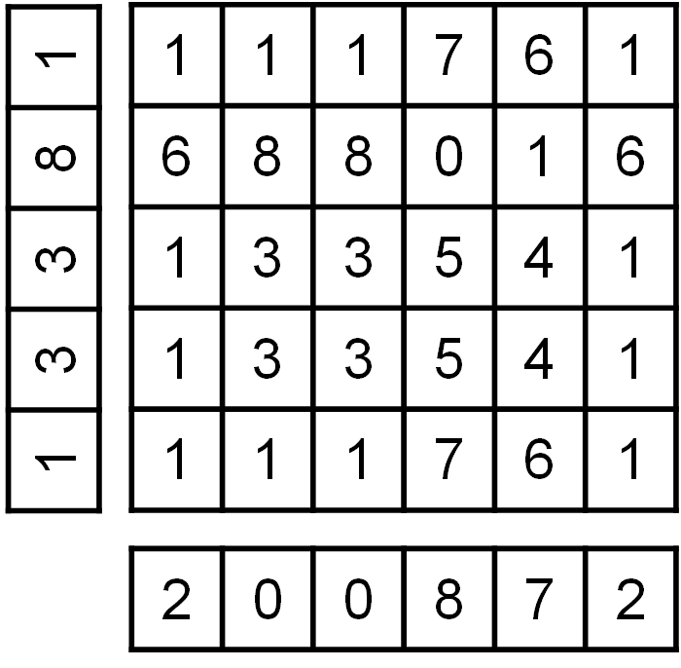
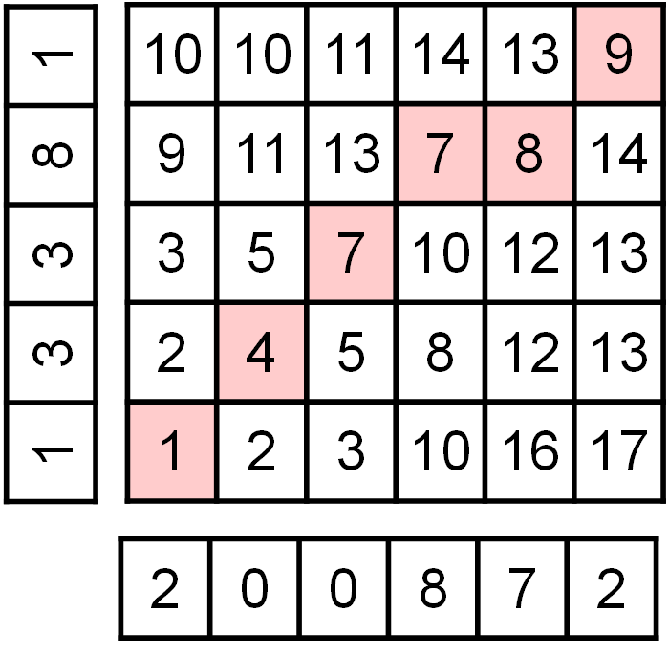
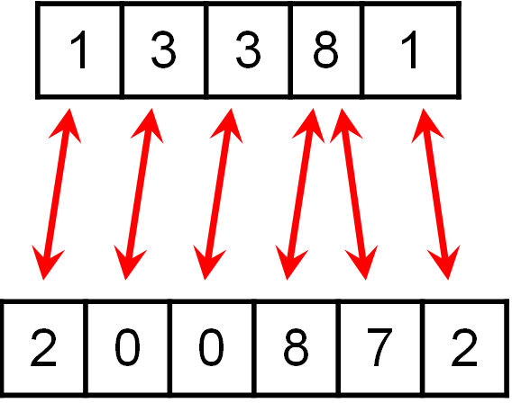
3.2 Dynamic Time Warping
Fig. 3.16

Slide 29
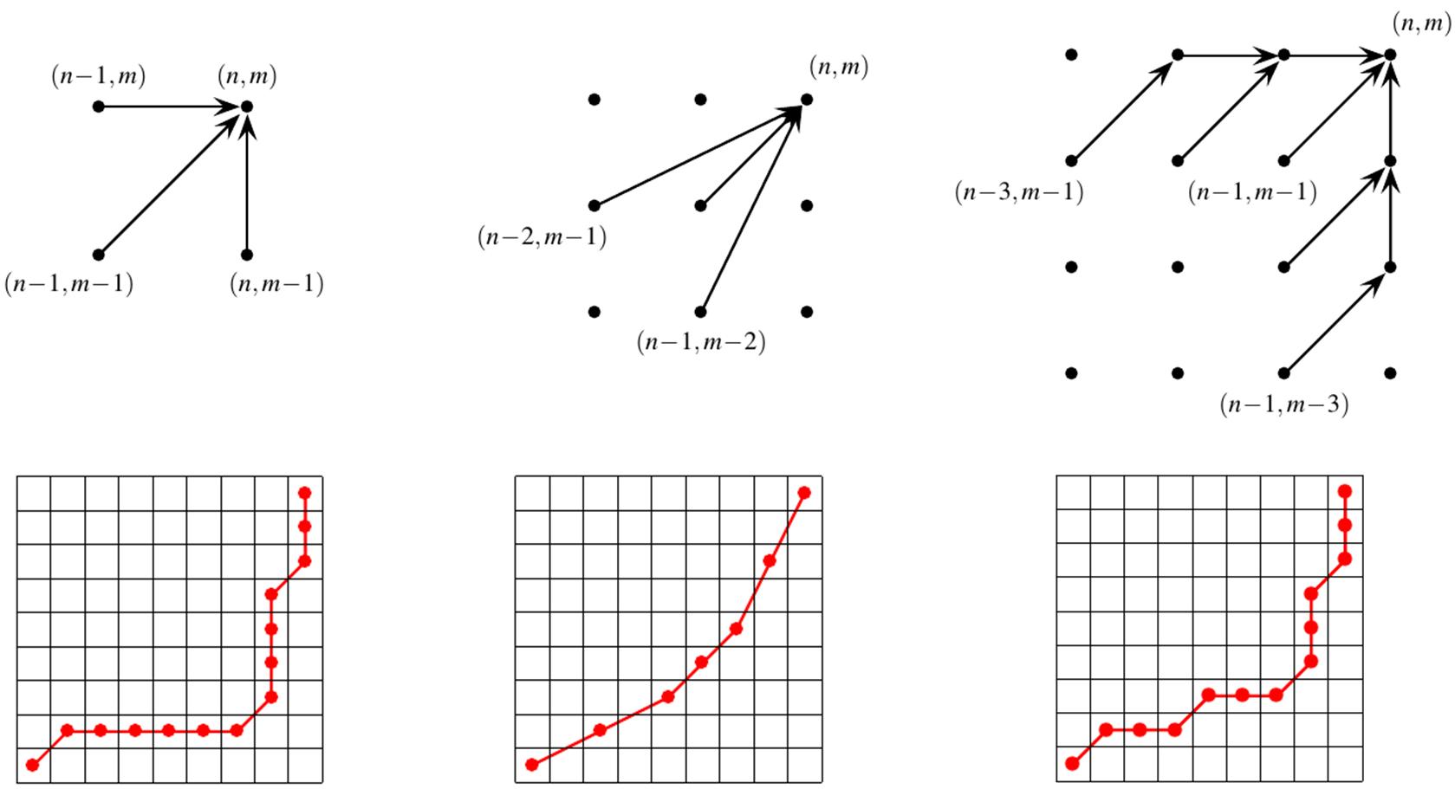
3.2 Dynamic Time Warping
Fig. 3.17

Slide 30
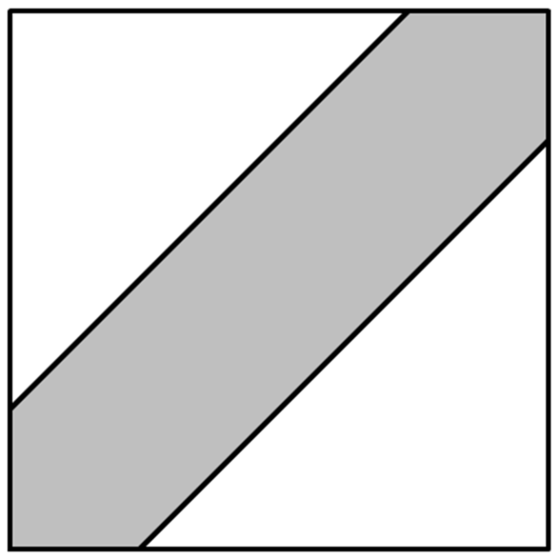
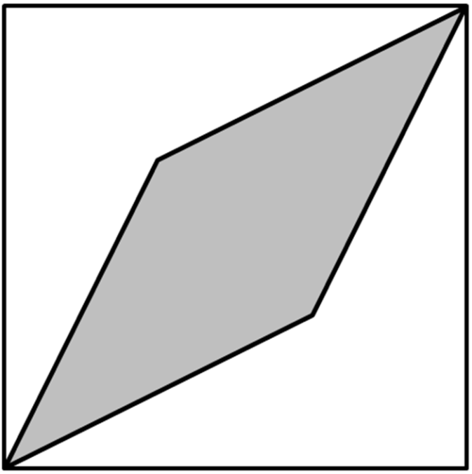
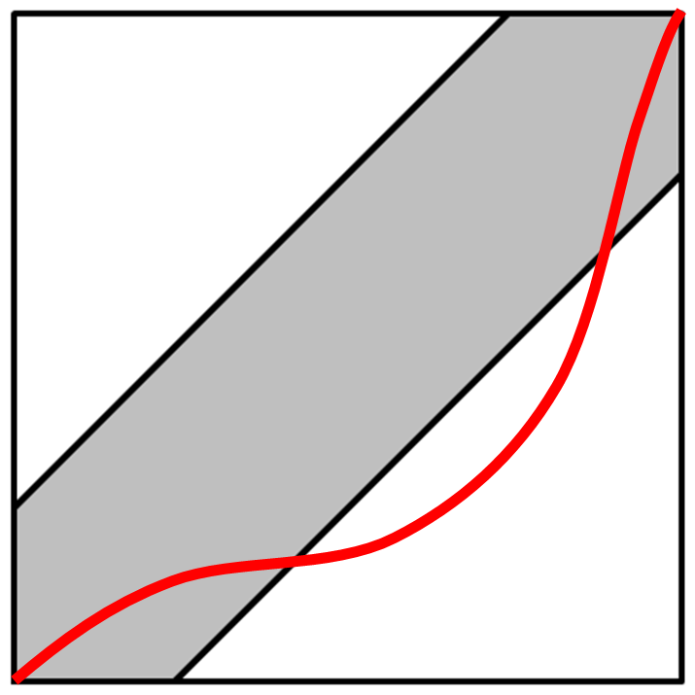
3.2 Dynamic Time Warping
Fig. 3.18

Slide 31
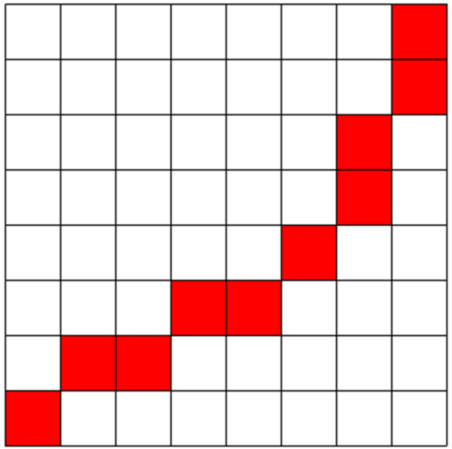
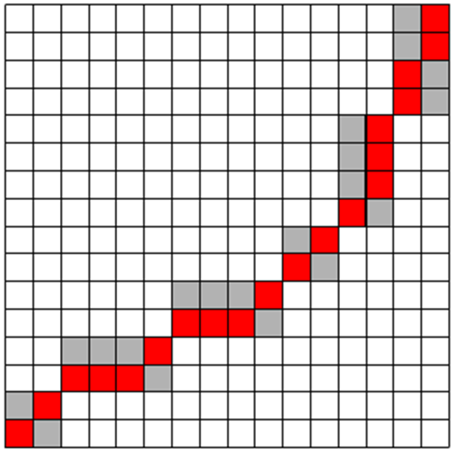
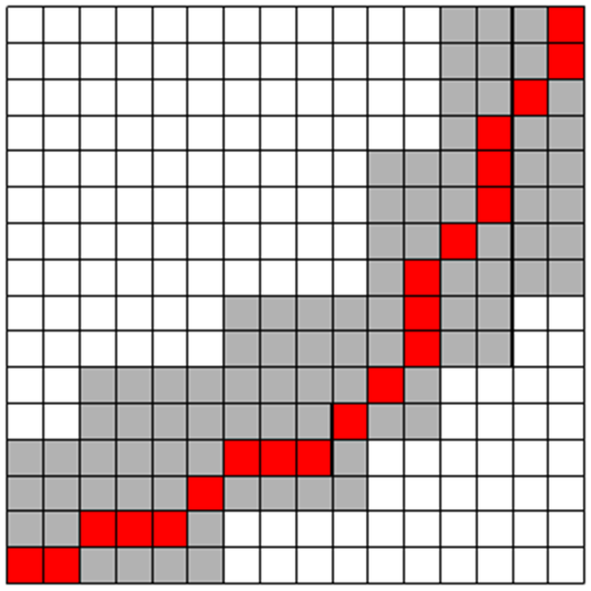
3.2 Dynamic Time Warping
Fig. 3.19

Slide 32
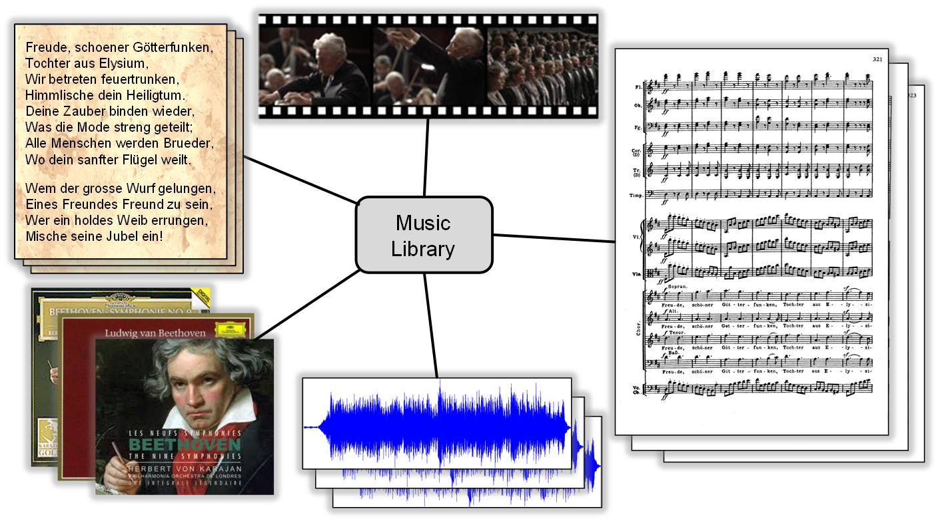
3.3 Applications
Fig. 3.20

Slide 33
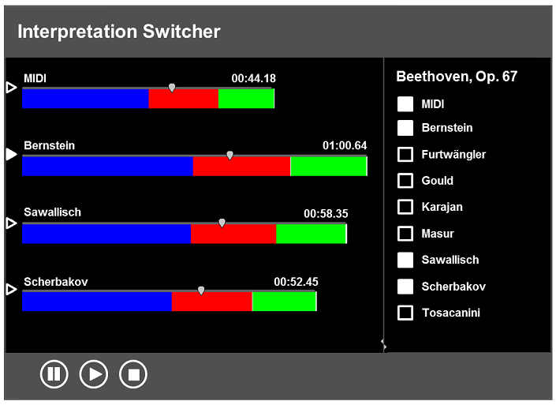
3.3 Applications
Fig. 3.21

Slide 34
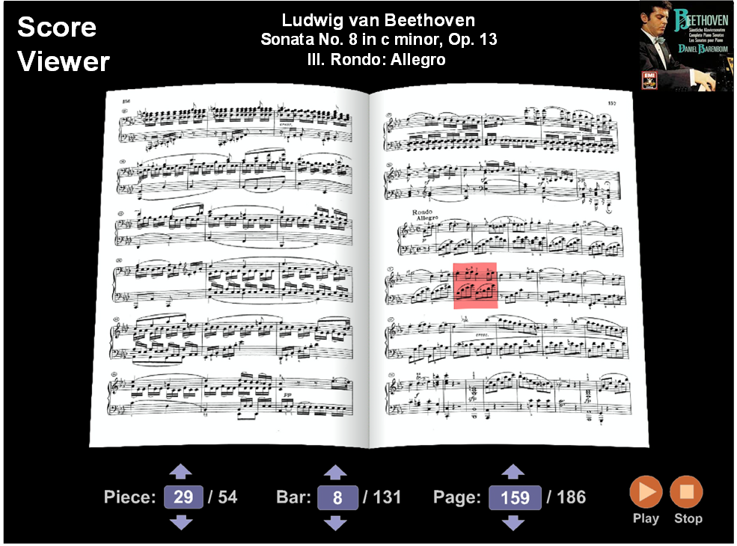
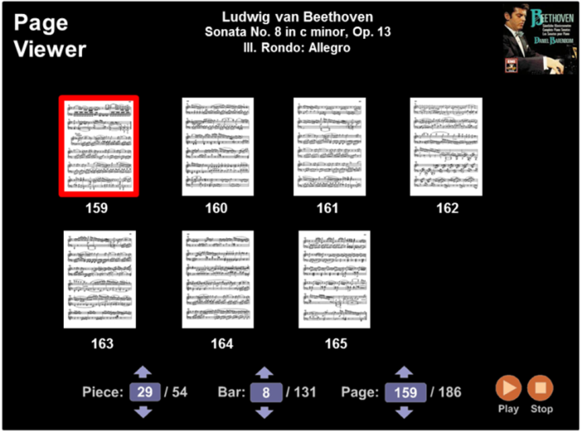
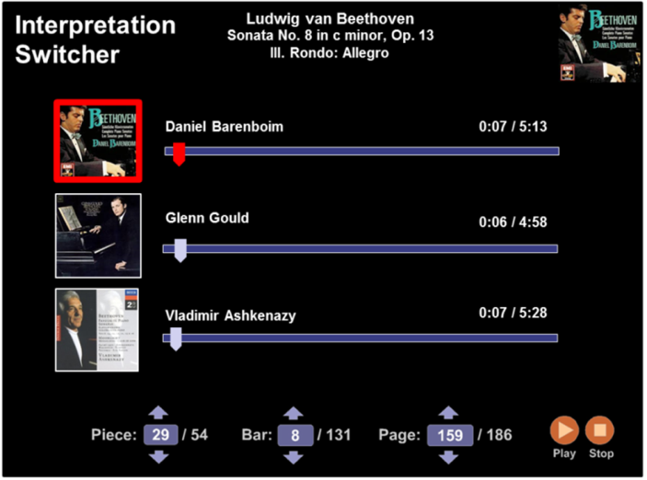
3.3 Applications
Fig. 3.22

Slide 35
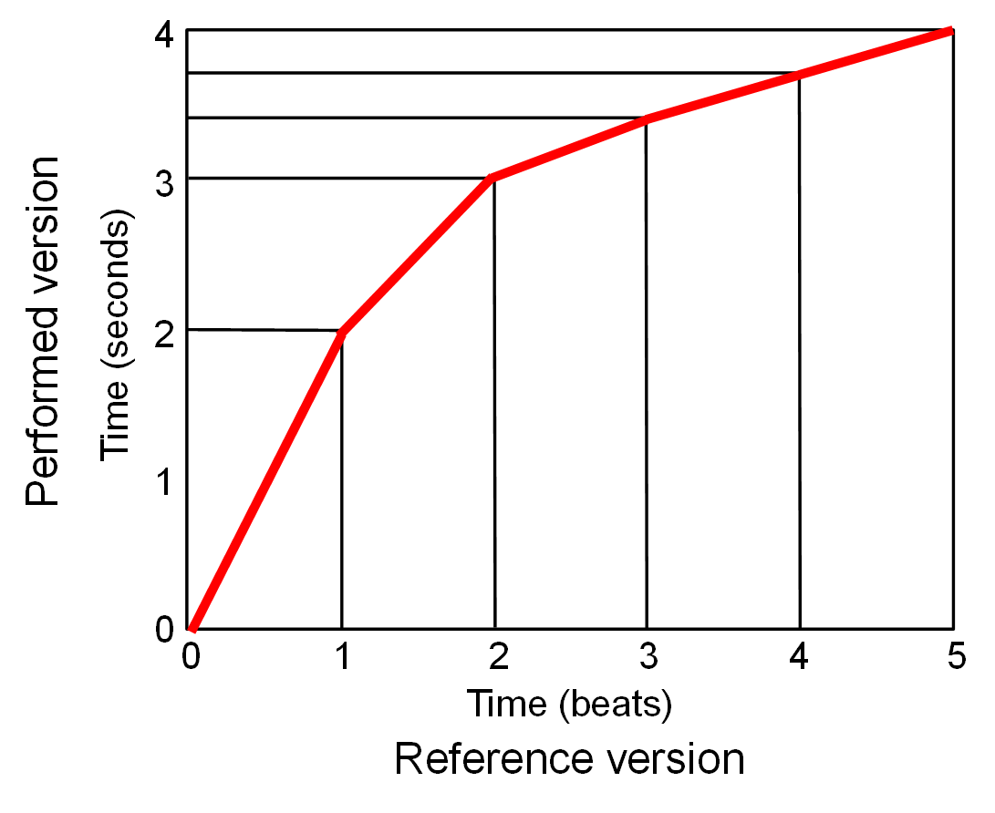
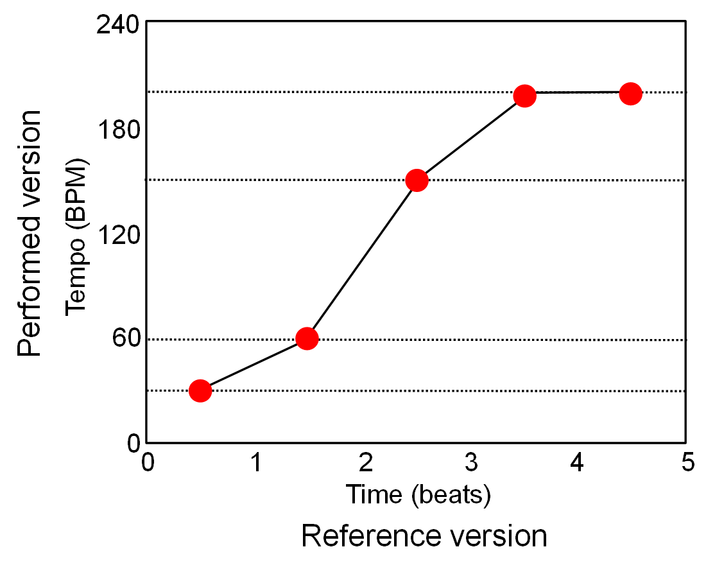
3.3 Applications
Fig. 3.23

Slide 36
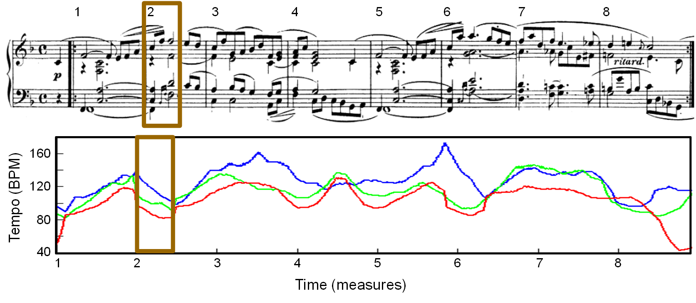
3.3 Applications
Fig. 3.24

Slide 37
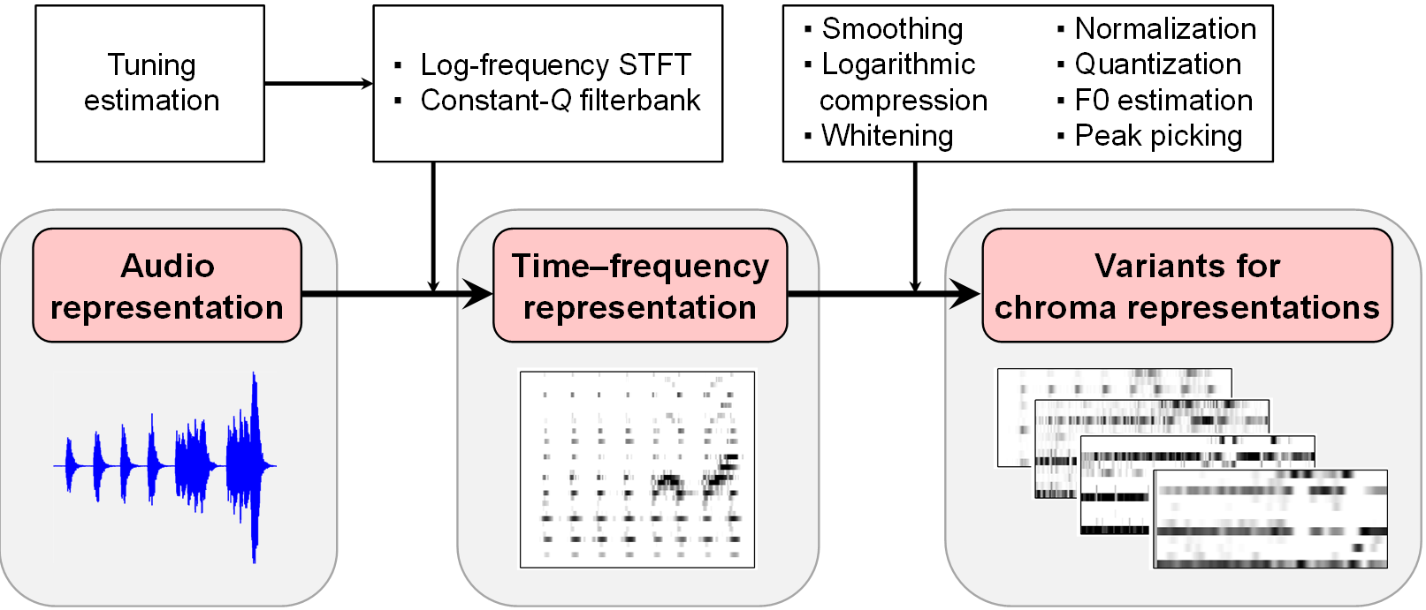
3.4 Further Notes
Fig. 3.25

Slide 38
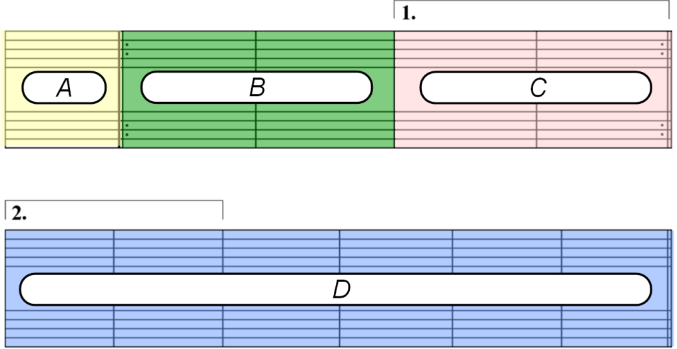

3.4 Further Notes
Fig. 3.26

